Slide 1
Capstone Engagement
Assessment, Analysis, and Hardening of a Vulnerable System

Slide 2
Table of Contents
This document contains the following sections:
01
Network Topology
02
Red Team: Security Assessment
03
Blue Team: Log Analysis and Attack Characterization
Hardening: Proposed Alarms and Mitigation Strategies
04

Slide 3
Network Topology
‹#›

Slide 4
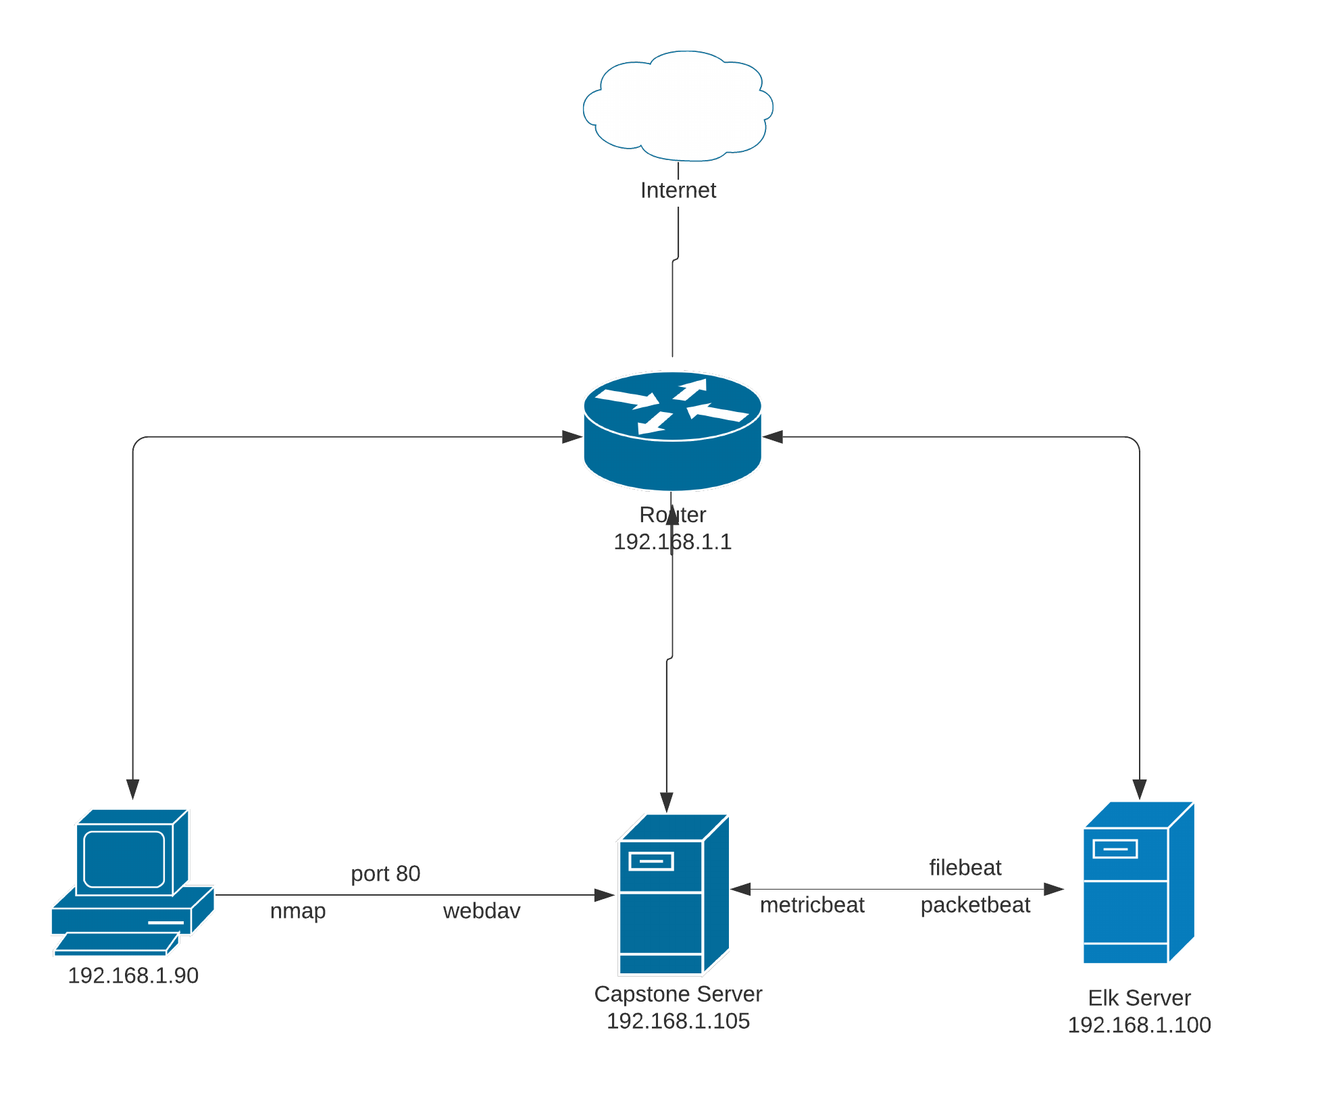
Network Topology
[Insert Here]
Network
Address Range:192.168.1.0/24
Netmask:255.255.255.0
Gateway: 10.0.0.76
Machines
IPv4: 192.168.1.90
OS: Linux
Hostname: Kali
IPv4: 192.168.1.105
OS: Linux
Hostname: Capstone
IPv4:192.168.1.100
OS:Linux
Hostname: Elk
IPv4:192.168.1.1
OS: Windows
Hostname: ML-RefVM684427

Slide 5

Red Team
Security Assessment
‹#›

Slide 6
Recon: Describing the Target
Nmap identified the following hosts on the network:
Hostname | IP Address | Role on Network
ML-RefVm684427 | 192.168.1.1 | Router
Elk | 192.168.1.100 | Monitoring Logs
Kali | 192.168.1.90 | Attacker Machine
Capstone | 192.168.1.105 | Vulnerable Server

Slide 7
Vulnerability Assessment
The assessment uncovered the following critical vulnerabilities in the target:
Vulnerability | Description | Impact
Sensitive Data exposure | LFI allows access into confidential files on a state | An LFI vulnerability allows attackers to gain access to sensitive credentials
Weak passwords | Weak password allows brute forcing into the system easily | A weak password vulnerability allows attackers to brute force into the system using hydra or john the ripper commands.
LFI vulnerability | This allows the attacher gain access to system using remote code execution | Using remote code script user can gain access to the shell.
Read/Write permissions | This vulnerability allows writing files to server | This vulnerability allows the attacker to drop a payload in webdav folder and gain access to the system.

Slide 8
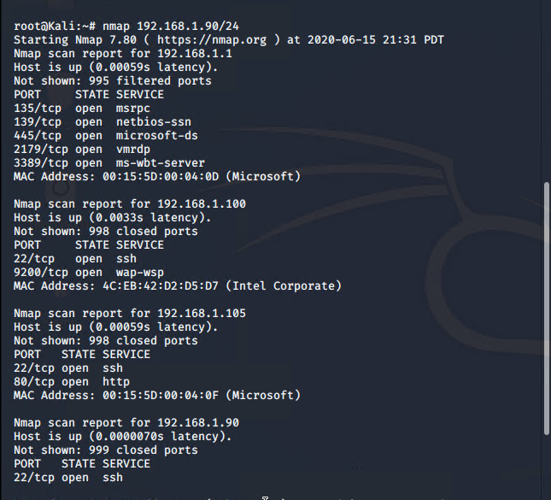
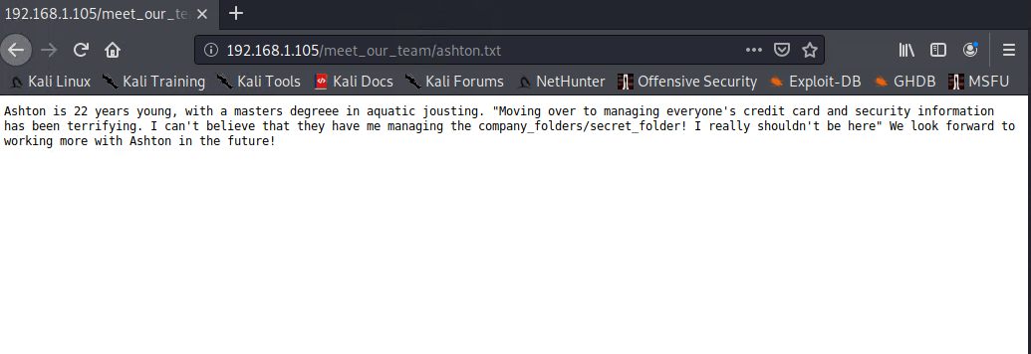
Exploitation: Sensitive data exposure
01
02
03
Tools & Processes
Using nmap I learnt thaat port 80 was open on ip Capstone machine.
Achievements
I quickly gained access using web browser. The company_folder revealed confidential information. Based on information I could gain access to the secret_folder
[screenshot]

Slide 9
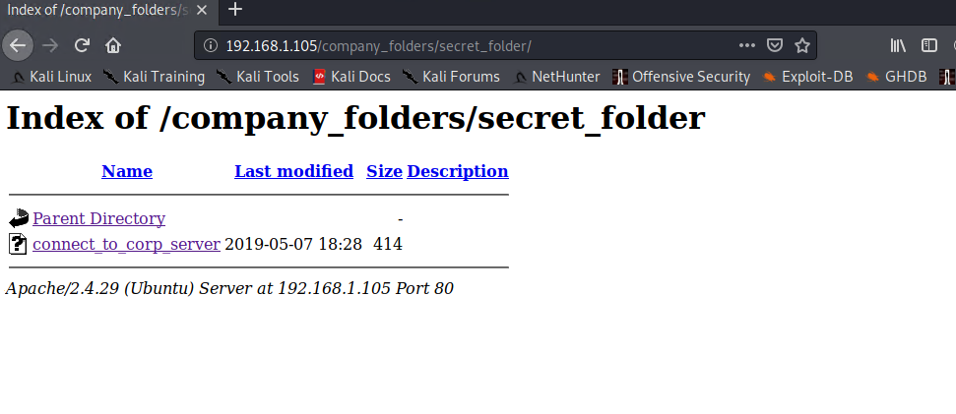
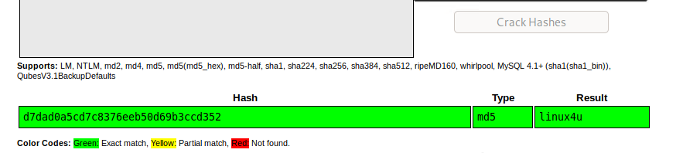
Exploitation: Weak credentials
01
02
03
Tools & Processes
By guessing the username ashton and ryan from ashton’s file, I used hydra to crack to
Achievements
Using the password generated by hydra, I could gain access to the secret_folder
[INSERT: screenshot or command output illustrating the exploit.]

Slide 10
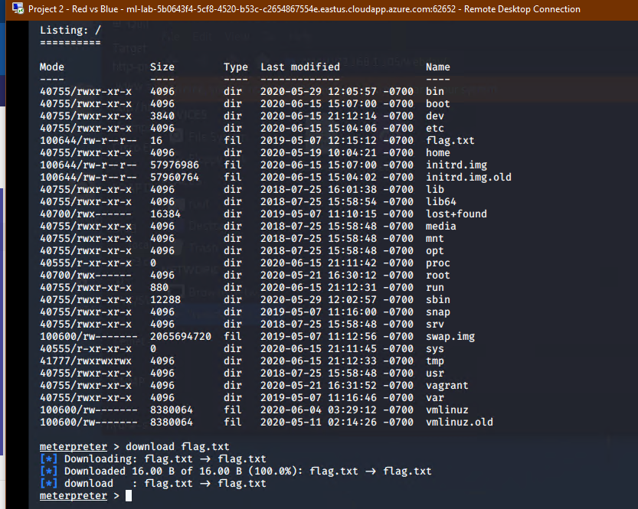
Exploitation: LFI vulnerability
01
02
03
Tools & Processes
Using msfvenom I generated a payload and dropped into the capstone server.
Achievements
Using meterpreter I could gain access to the shell of the system.
[INSERT: screenshot or command output illustrating the exploit.]

Slide 11
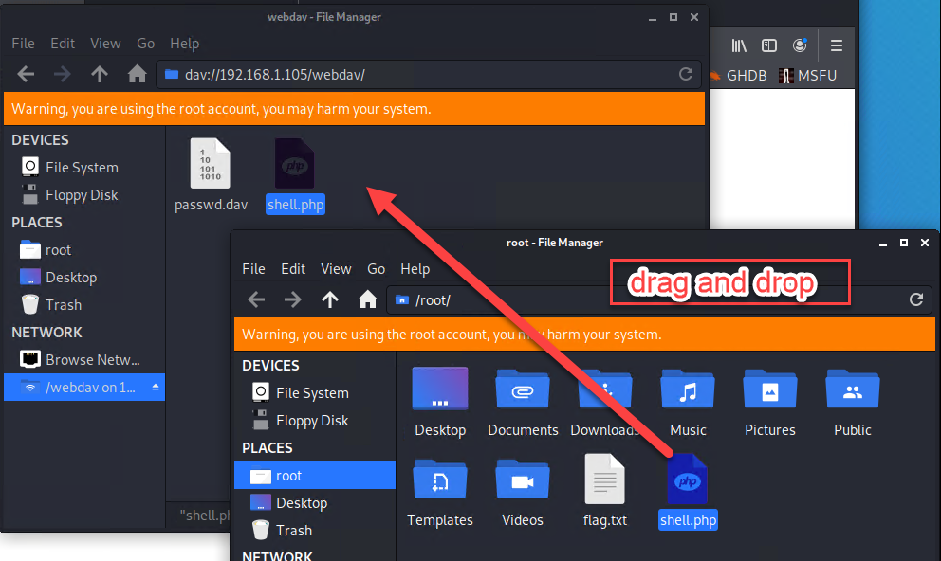
Exploitation: Read/Write access
01
02
03
Tools & Processes
I tried pasting file on the Capstone webdav directory
Achievements
The file was pasted in the directory.

Slide 12

Blue Team
Log Analysis and Attack Characterization
‹#›

Slide 13

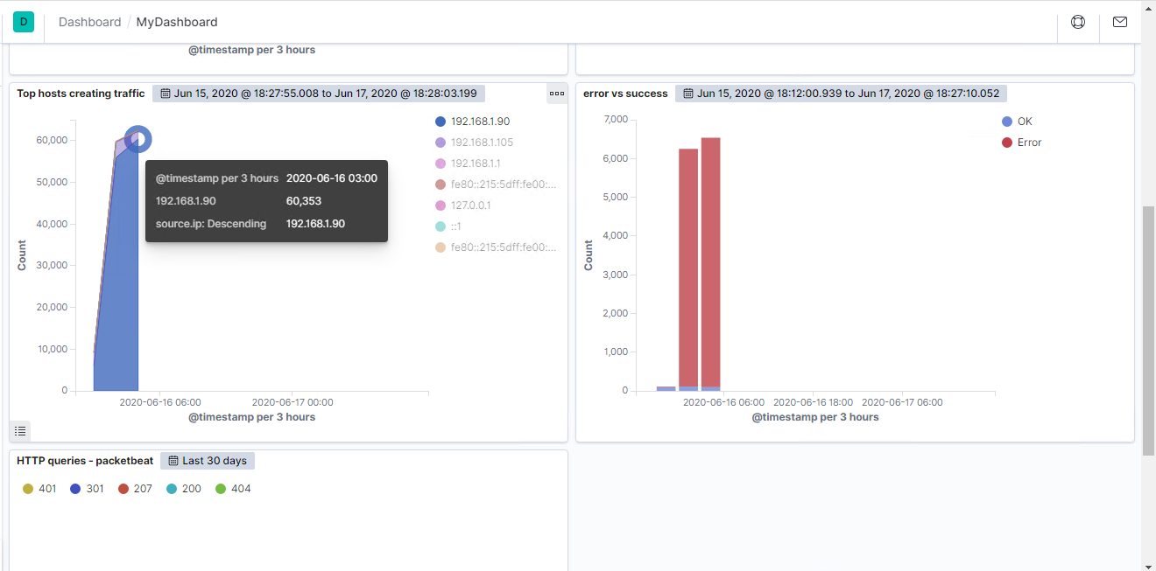
Analysis: Identifying the Port Scan
Answer the following questions in bullet points under the screenshot if space allows. Otherwise, add the answers to speaker notes.
What time did the port scan occur?
How many packets were sent, and from which IP?
What indicates that this was a port scan?
Port scan occurred on June 16, 2020 around 3AM system time.
Around 60,353 packets were transferred
The sudden spike in network flow and error and success transactions indicates this is a port scan.

Slide 14
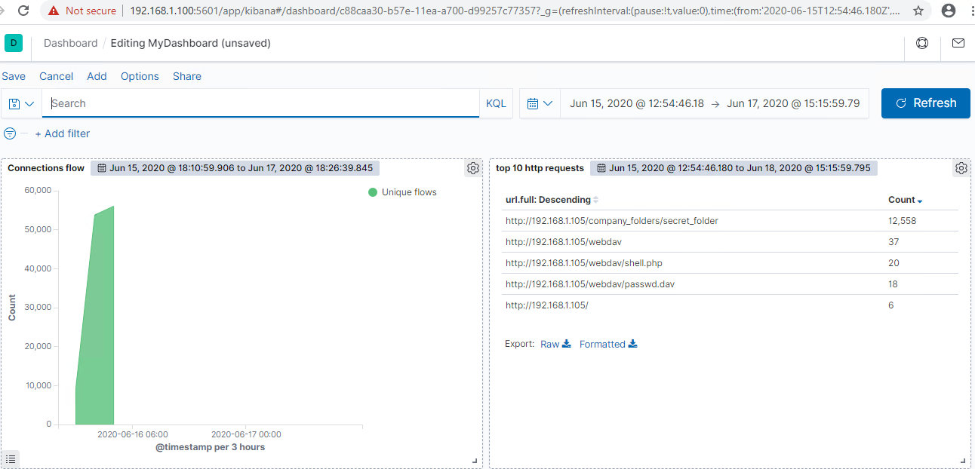
Analysis: Finding the Request for the Hidden Directory
Answer the following questions in bullet points under the screenshot if space allows. Otherwise, add the answers to speaker notes.
What time did the request occur? How many requests were made?
Which files were requested? What did they contain?
The request occurred on June 16, 2020 around 4:45 AM
Around 12,568 requests were made to the secret_folder.
The folder contained a file named connect_to_corp_server

Slide 15
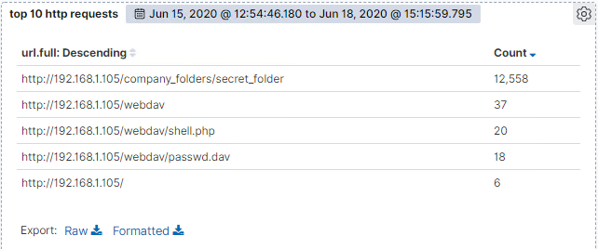
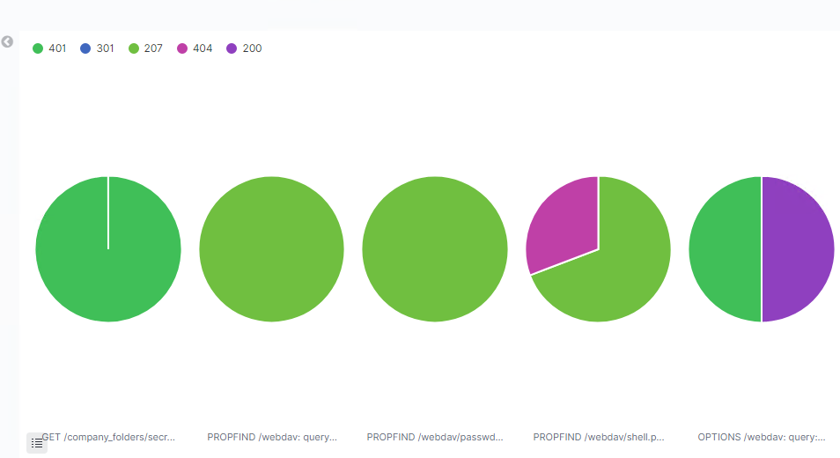
Analysis: Uncovering the Brute Force Attack
Answer the following questions in bullet points under the screenshot if space allows. Otherwise, add the answers to speaker notes.
How many requests were made in the attack?
How many requests had been made before the attacker discovered the password?
Around 12558 attempts were made and only 3 succeeded.

Slide 16
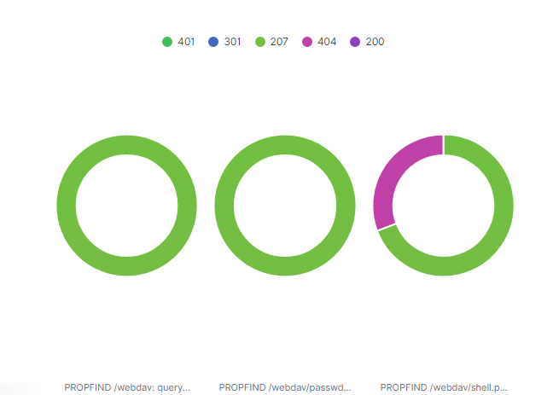
Analysis: Finding the WebDAV Connection
Answer the following questions in bullet points under the screenshot if space allows. Otherwise, add the answers to speaker notes.
How many requests were made to this directory?
Which files were requested?
Around 37 requests were made to Webdav directory.
Shell.php and passwd file was requested.

Slide 17
Blue Team
Proposed Alarms and Mitigation Strategies
‹#›

Slide 18
Mitigation: Blocking the Port Scan
An alarm can be setup when the connection flow from network beat is higher than 3000 count.
There is no way to defeat port scans. The only way to limit port scans is to close all the unneccessary ports that are open.

Slide 19
Mitigation: Finding the Request for the Hidden Directory
An alarm can be setup for any machine that attempts to access this directory or file for a threshold number of times
The threshold can be 3 to 5 times.
The secret_folder should be deleted or stop sharing for public access.

Slide 20
Mitigation: Preventing Brute Force Attacks
We can setup an alarm if 401 unauthorised is returned by server for failed attempts after a threshold amount of time.
The threshold can be 5 times.
An account lockout policy should be set for every 3 or 5 unsuccessful attempts. The user should be locked for temporary period.
Choose a complex username and password

Slide 21
Mitigation: Detecting the WebDAV Connection
We can set an alarm for any unauthorized machine trying to access the webDAV directory.
The access to this folder should be provided through port 80.
The username and pasword to this directory should be complex.

Slide 22
Mitigation: Identifying Reverse Shell Uploads
An alarm can be set for traffic coming through port 4444.
Another alarm can be set for any kind of upload operation being performed on webdav folder.
Read only access should be set to the webdav folder.
If using a firewall, allow only the necessary ports to access the folder. Block other ports.

